Slide 1
Dentistry and Sedation Care
Sean G. Boynes, DMD, MS

Slide 2
Patient Pain and Anxiety Experience
Majority of dental encounters do not require pharmacologic intervention
Benefits with the administration of sedation and/or anxiolytic agents has been observed
Sedation and general anesthesia care historically associated with pediatric dental care administration
70% of board certified pediatric dentists administer some form of sedation
60% would hire an anesthesiologist if one were available
Olabi et al. Anesth Prog 2012;59:12-17; Feck et al. Dent Economics 2009;99:24-26; Jackstein, 2012 – Ohio State Dissertation
Notes:
It has been suggested that availability of pharmacologic intervention to dental patients impacts practice marketability and revenue.

Slide 3
Policy, Guidelines and Regulations
Many variations with sedation/anesthesia in terms of administration, education, and oversight
Fluctuations seen from a list of influences
Individual providers
Multifaceted organizations
Litigation processes
Legislative action
From 2006-2010
U.S. dental boards approved 65 sedation related regulation changes at 13 changes per year
From 1998-2005 the yearly average was less than 2
Boynes SG. Decis Dent 2016; 2(6): 16-22
Notes:
Correlation can be observed between regulatory alterations in the
dental field and those occurring within medical anesthesiology. This
period is associated with the growth of ambulatory surgical centers and
procedural sedation,8 and a peak in the use of oral sedation for dental
treatment.2 It also heralded the first Commission on Dental Accreditation
and Accreditation Council for Graduate Medical Education accrediting
dental anesthesiology training programs,9 as well as new
guidelines from the American Dental Association (ADA) and American
Academy of Pediatric Dentistry (AAPD).10

Slide 4
So, Here are some good resources:
ADA Guidelines:
http://www.ada.org/~/media/ADA/Education%20and%20Careers/Files/anesthesia_use_guidelines.pdf?la=en
AAPD Guidelines:
http://www.aapd.org/media/policies_guidelines/g_sedation.pdf
AANA Guidelines
http://www.aana.com/resources2/professionalpractice/Pages/Standards-for-Office-Based-Anesthesia-Practice.aspx
Pennsylvania Sedation Regulations
http://www.pacode.com/secure/data/049/chapter33/subchapetoc.html
Organized Dental Anesthesiology
www.adsahome.org
www.asdahq.org

Slide 5
Boynes SG. Decis Dent 2016; 2(6): 16-22
Notes:
One of the more consistent changes…

Slide 7
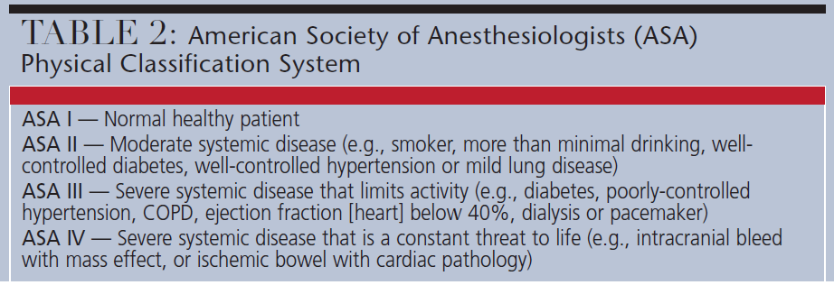
Notes:
As seen in Table 2, the American Society of Anesthesiologists
(ASA) Physical Classification System is a central
part of an evaluation for sedation services. Most patients
treated with conscious sedation in the dental office are
categorized as ASA I or II patients.10,12 By comparison,
ASA III and IV patients may have specific risks that require
more focused care, and usually undergo treatment in a
hospital and/or specialist environment.13

Slide 8
Sedation Treatment Planning
Deciding on the level of sedation or anesthesia necessary is generally based on
patient characteristics and behavior
anticipated dental treatment
provider experience.
Few tools are available/focus on anxiety
Corah’s and Modified dental anxiety scale most popular
More likely to rely on indications and contraindications
Williams et al. The Cochrane Library. 2015:9

Slide 9
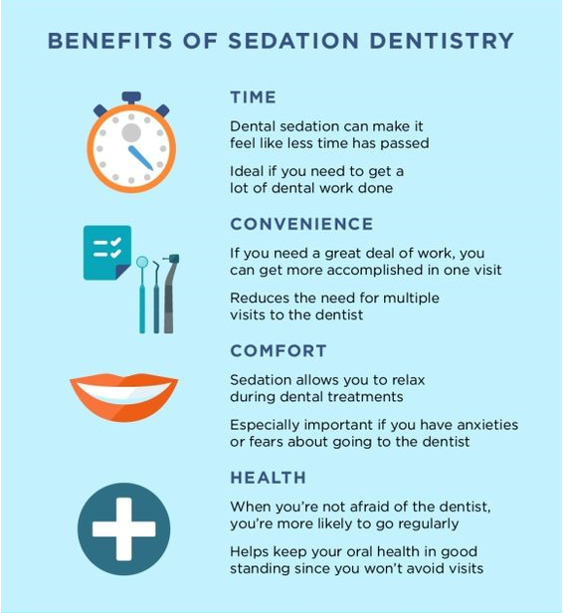

Slide 12
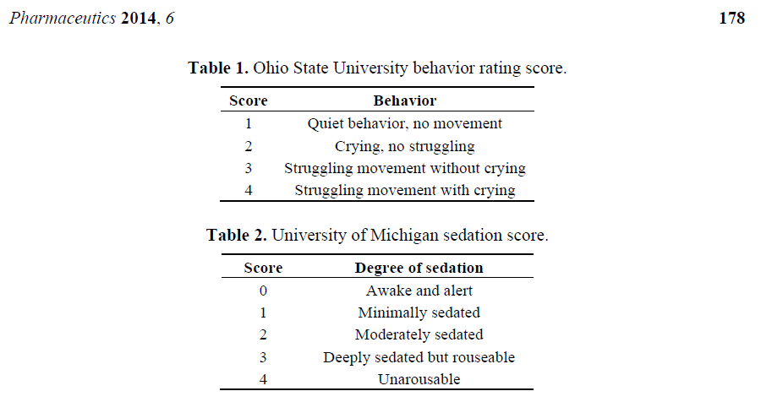
Additional tools…

Slide 13
Temperament and Nitrous Oxide
[Failure of Nitrous oxide administration] “Effortful control is associated with behavior during dental treatment”
Attention control
Inhibitory control
Perceptual sensitivity
Low-intensity pleasure
Frustration, fear, sadness, soothability, activity, and impulsivity can also serve as determinants.
Nelson et al. Anesth Prog 2017: 64:17-21.

Slide 14
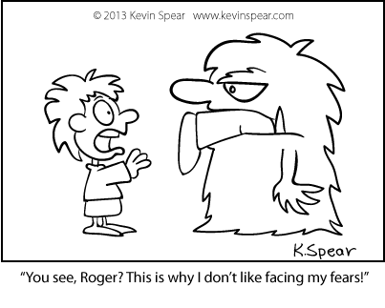
Fear and Anxiety

Slide 15
Parent of Patient Anxiety Evaluation
Prospective questionnaire-based analysis (early stage of data collection)
Evaluating
Anxiety levels
Dental knowledge
Parent dental treatment history
Evaluation of communication process between parent and pediatric patient
Boynes SG. Et al. J Oral Biology and Dentistry 2014; 2:2-9

Slide 16
Corah’s Anxiety Scale
A series of questions relating to a dental visit
Anxiety rating:
• 9 - 12 = moderate anxiety but have specific stressors that should be discussed and managed
• 13 - 14 = high anxiety
• 15 - 20 = severe anxiety (or phobia). May be manageable with the Dental Concerns Assessment but might require the help of a mental health therapist.
All respondents (AR): 11.65
Parents of patients that required referral to moderate or deep sedation/general anesthesia (RP): 15.52

Slide 17
Points of Measurement
Parent needs sedation care
AR: No (57.1%)
RP: Yes (75.0%)
Discuss appointment with child
AR: Yes (88.9%)
RP: Yes (81.2%)
Description of parent’s dental visit to child
AR:
Positive (58.9%)
Negative experience (8.0%)
As a positive experience but told them about a difficult appt I had in the past (19.6%)
Negative experience, but told them there appointment would be better (13.5%)

Slide 18
Parent Past Dental Experience
Parent had a bad experience with dental care in the past
AR: 50.1%
RP: 75.0%
Description of parent bad experience (total selections)
1 – Dentist’s attitude, way you were treated (24.1)
2 – Significant pain during procedure (21.3)
3 – I did not get numb and the dentist continued drilling anyway (20.6)
4 – Getting a shot (19.1)

Slide 19
Scripting Communication
Basic instruction to staff will include brief information on three verbal approaches to patient/parent fear.
The permissive approach (provide relevant information regarding treatment to relieve uncertainty);
The empathetic approach (share another person’s feelings);
The personal approach (create the feeling that a personal relationship exists).
Sarnat H, et al. (2001) Pediatric Dentistry 23:337-342.
Hooper EM, et al. (1982) Med Care 20:630-638.
Notes:
All three approaches should be used when generally communicating with a patient or parent; however, the empathetic approach has been found most effective with behavior and anxiety.

Slide 20
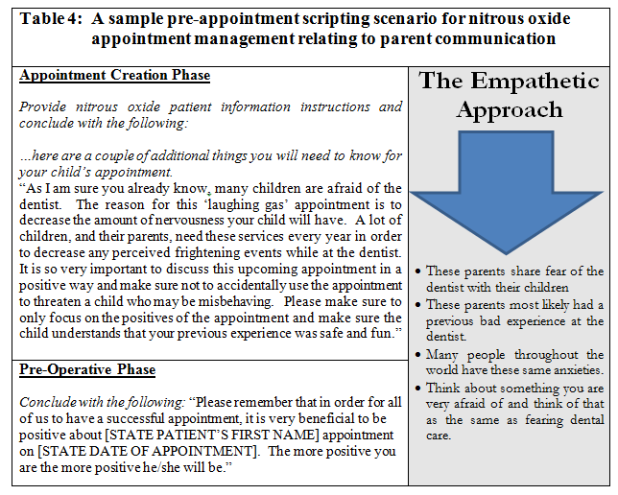

Slide 21
Roles and Responsibilities

Slide 22
Roles and Responsibilities
Sedation is an accepted modality of dentistry and a necessary tool to provide treatment for many populations
So, an organization must plan to address patient need:
Outsourcing
Referral to a specialist or hospital system for comprehensive care
Insourcing
Independently obtaining the skill set
Contracting with a third party

Slide 23
Roles and Responsibility
Ultimately, the treating dentist is responsible for the welfare of his or her patients, and should verify that the administration of sedation meets both professional standards and state practice regulations.
Regardless of third party contractor qualifications
Pennsylvania State Dental Board requires that dentists working in an office where anesthesia/sedation administration occurs must have 5 hours of continuing education specific to anesthesia/sedation care.
http://www.pagd.org/new-item2/new-item5
Notes:
The objective of these requirements is to
have the dentist maintain a knowledge base that minimizes patient risk
and provides peer accountability. It should be noted that only dentists who
have completed an advanced course of education (meeting ADA standards)
are qualified to administer deep sedation or general anesthesia.

Slide 24
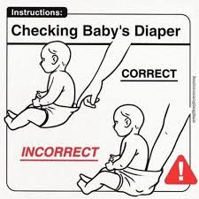
Roles and Responsibilities
Creation and ongoing implementation of policy and procedures that includes the sedation care procedures and emergency management plan
Recommended to have emergency event policy and procedure review and assignment of provider and staff roles at least once per year
Notes:
Provide sedation procedure template

Slide 25
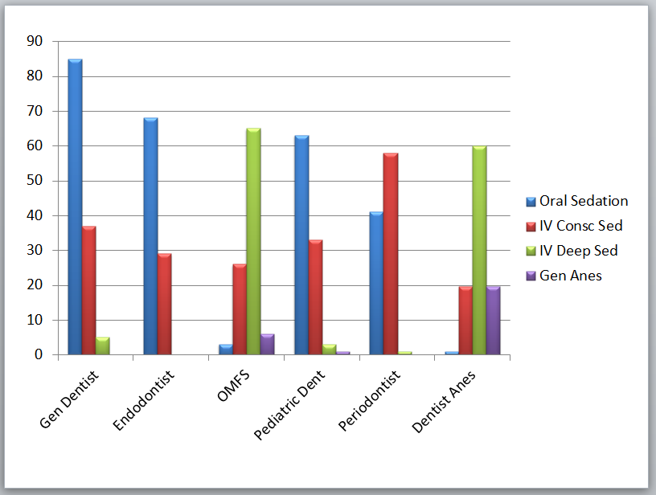
Practice Characteristics
Boynes SG et al. Anesth Prog. 2010;57:52–58.
Notes:
Throughout the U.S., there are regional and discipline-specific differences
in the clinical practice of sedation.1,19 As seen in Figure 1 (page 22), general dentists,
endodontists and pediatric dentists were more likely to administer oral
sedation, while oral and maxillofacial surgeons, dentist anesthesiologists
and periodontists administered intravenous sedation most often.

Slide 26
Practice Characteristics
In an analysis of 717 U.S. dental anesthesia/sedation permit holders,
Oral surgery case types were most often associated with sedation services, followed by:
Implant cases
Pediatric dentistry
Boynes SG et al. Anesth Prog. 2010;57:52–58.

Slide 27
Practice Characteristics & ASA Status
Majority of sedation providers treat healthy patients
ASA I individuals comprise 60-80% of sedation schedules
Dentist and physician anesthesiologists were most likely to see ASA II and ASA III patients in an office-based dental setting
NO PROVIDER REPORTED CARING FOR AN ASA IV PATIENT
Surveyed dentists did not desire to take on the risk of sedation medically compromised individuals due to concerns over possible litigation and/or poor outcomes.
Boynes SG et al. Anesth Prog. 2010;57:52–58 Adams AC. 2015, University of Toronto Dissertation.
Boynes SG. Dec Dent 2015; 16-19.

Slide 28
Health and Social System Considerations
Wages lost by parents
$2698 for general anesthesia
$2203 for sedation
Hospital based care cost 13.2 times more than ambulatory care at a dental school [Stony Brook University]
Hospital care required more operating time (+47 min)
Hospital care required more recovery time (+132 min)
Lee JY et al. Anesth Prog 2001; 48:82-88
Rashewsky et al. Anesth Prog 2012; 59:147-153
Notes:
So chose patients wisely and correctly

Slide 29
Summary
Sedation is an important component of comprehensive dentistry
Growth in the use of this modality has been observed over the last two decades
Providers and patients must weigh risks and benefits
There is a great deal of variation with sedation practice in dentistry

Slide 30
Questions?

